Slide 1







Welcome !
Mentor Meeting 1.7.21

Slide 2
Cohort Review 2021 – 2022
10 MFL trainees + 1 Returner from LoA
9 left with QTS recommendation
(1 LoA, 1 with an additional placement)
8 secured employment in a school
2 are still looking for a teaching position in England / abroad

Slide 3
Composition by Route
Route | 2019-20 | 2020-21 | 2021-22
Core | 14 | 19 | 4
All Saints | 4 | 4 | 2
Pathfinder | 2 | 3 | 3 (+1)
Teach North | - | 1 | 1
YTSA | 2 | 2 | -
Total | 22 | 29 | 10 (11)

Slide 4

Composition by Language
FL1 | 2019-20 | 2020-21 | 2021-22
French | 11 | 14 | 3 (+1)
German | 4 | 4 | 3
Spanish | 7 | 11 | 4
Total | 22 | 29 | 10 (11)

Slide 5

Academic and Other Highlights
9 (+1) have QTS, passed all three assignments
8 have secured a first post in a school in England!
Mean scores of three Assignments: 2 Passes, 5 Merits, 3 Distinctions
No Fitness to Practice Issues !
Two highly successful research assignments
Translanguaging as a pedagogical practice to decolonise the Spanish
curriculum (88)
How can MFL teachers engage, motivate, and encourage boys
in a mixed ability MFL class? (82)

Slide 6
CCF Review 2021 – 2022
In February 2022, remaining Areas for Development
CCF 2 How Pupils Learn 2.4 and 2.5
CCF 3 Subject and Curriculum Knowledge 3.1 and 3.6 and 3.9
CCF 4 Classroom Practice 4.4 and 4.5 and 4.7 and 4.9 and 4.11
CCF 5 Adaptive Teaching 5.5 and 5.6
CCF 6 Assessment 6.2
CCF 7 Managing Behaviour 7.3
CCF 8 Professional Behaviours 8.5 and 8.6
In May 2022, no remaining CCF Areas

Slide 7
Looking Ahead 2022 – 2023
11 offers accepted
At least 2 with German as FL1
Native speakers from France, Luxembourg

Slide 8
ITT Provision – The National Picture
Market Review in 2020-21
In 2021-22 Re-accreditation process for ALL providers
Out of 216 providers, 80 have been re-accredited (37%)
UoY has DfE re-accreditation from 2024 onwards
We aim to expand into Primary
MFL: We teach explicitly phonics, vocab learning and grammar
2022-23 explicit teaching of the history of the subject and Decolonising the Curriculum (DEC)

Slide 9
R
M E M O R Y
C
L E A R N I N G
L
L CCF 2.1 to CCF 2.9

Slide 10
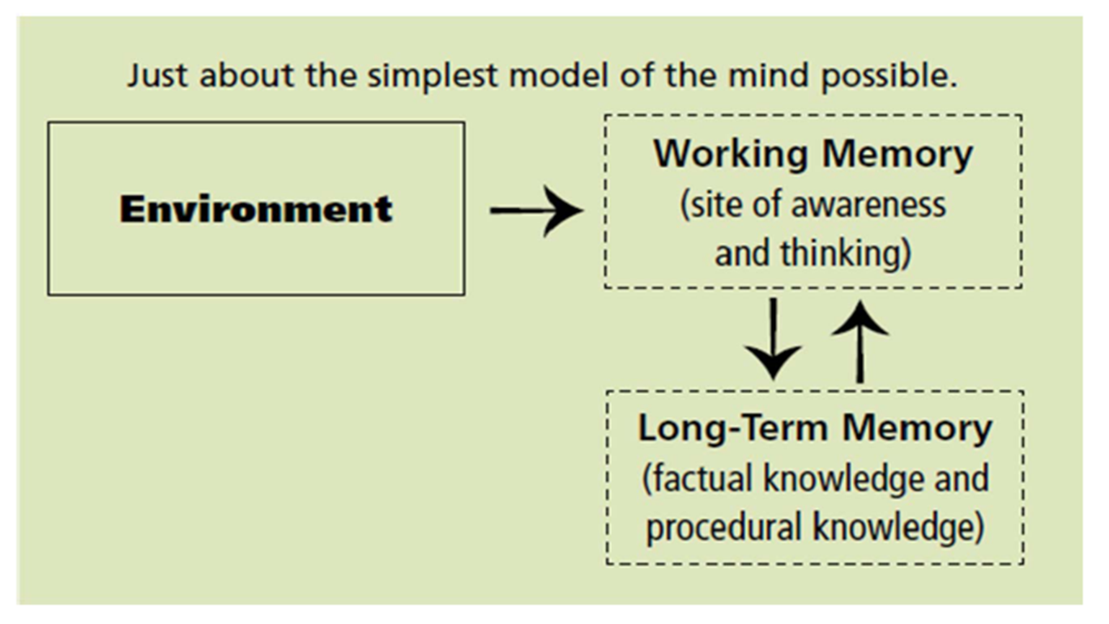

Slide 11
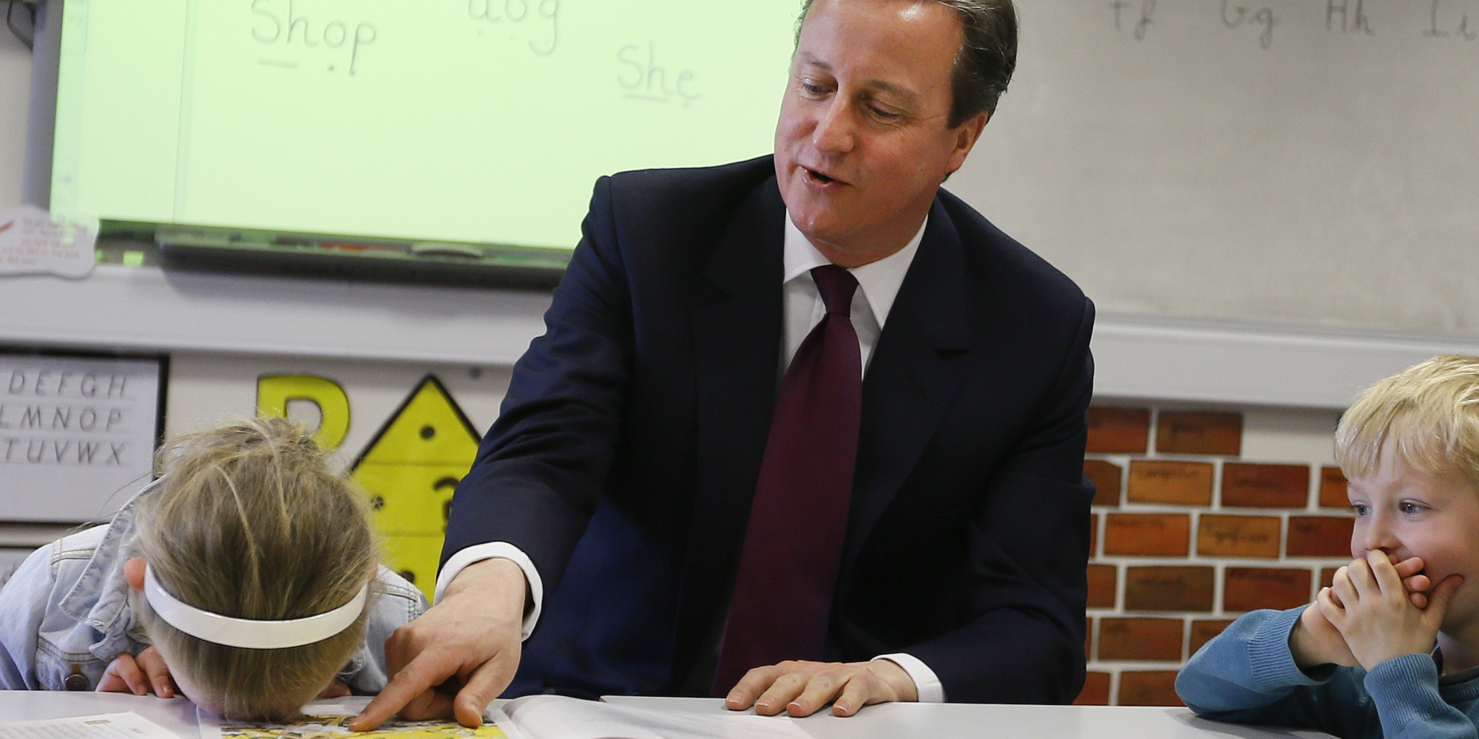
Cognitive Overload ?

Slide 12
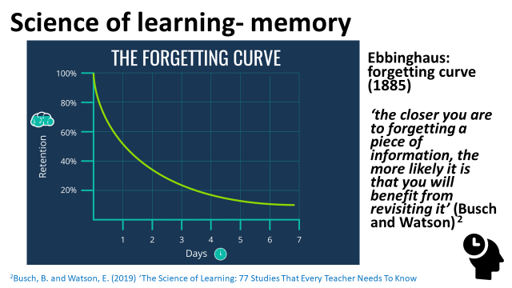

Slide 13
Ideas and Suggestions for 2022-23
NCLEP presentation to MFL mentors?
Present some CA content in MFL mentor meetings?
Using ideas from coaching in lesson observation feedback
Modelling of ‘how to make the most of lesson obs. with trainees AND set themes for observations in Sep/Oct/Nov
Is there a need for a proforma for planning sequences of lessons?

Slide 14
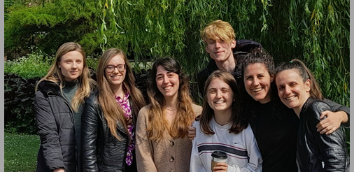

Slide 15


